Slide 1

Introduction to Relational Databases and Tables

Slide 2
Objectives
Compose and execute CREATE TABLE, ALTER, DROP, and TRUNCATE statements hands-on on a live database.
Create a database instance on the Cloud
Describe basic relational database concepts including tables, primary keys and foreign keys.
Compare and contrast Data Definition Language and Data Manipulation Language.
Develop ALTER, DROP and TRUNCATE statements.
Explain the syntax of the CREATE TABLE statement.
Introduction to Relational Databases and Tables

Slide 3
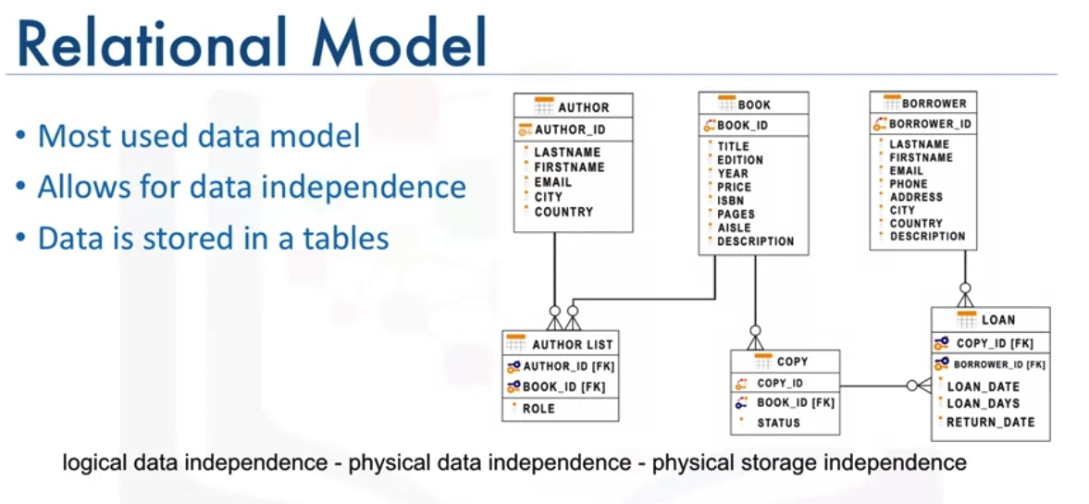
Relational Database Concepts
Introduction to Relational Databases and Tables

Slide 4
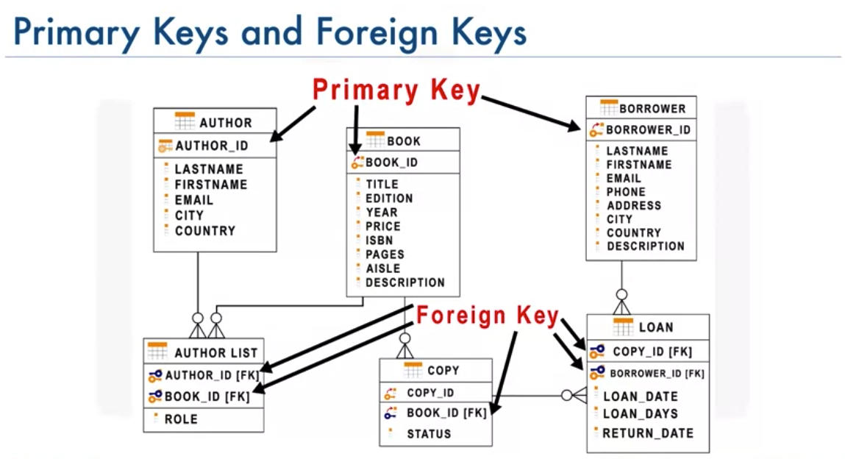
Relational Database Concepts
Introduction to Relational Databases and Tables

Slide 5
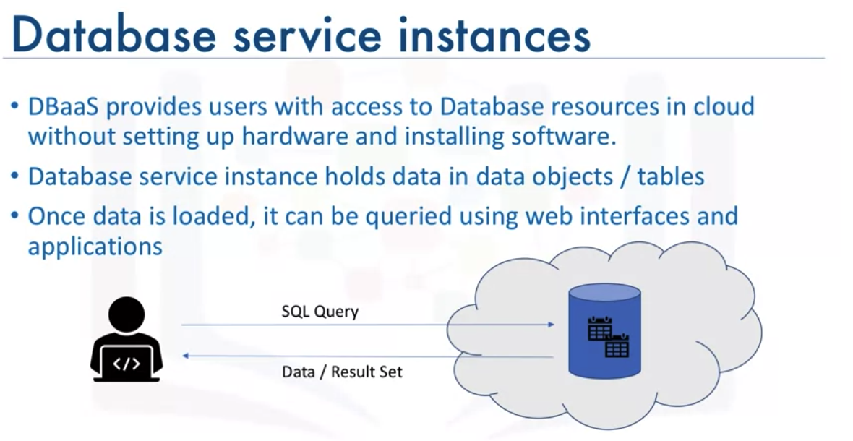
Create Database Instance on Cloud
Introduction to Relational Databases and Tables

Slide 6
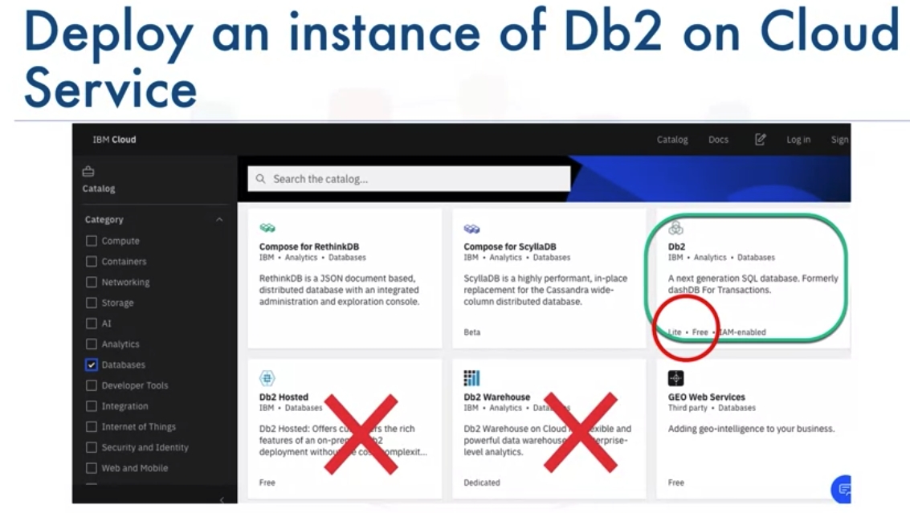
Create Database Instance on Cloud
Introduction to Relational Databases and Tables

Slide 7
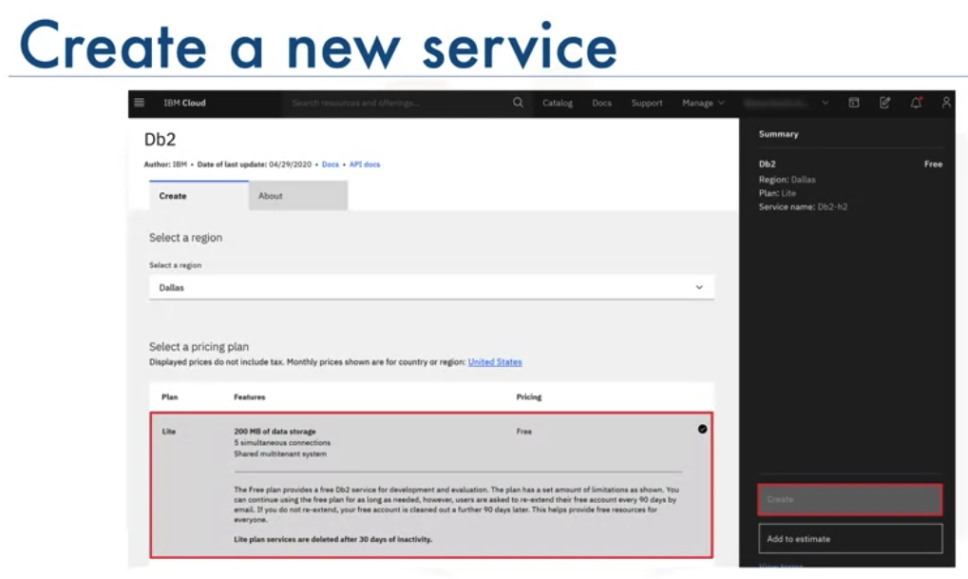
Create Database Instance on Cloud
Introduction to Relational Databases and Tables

Slide 8
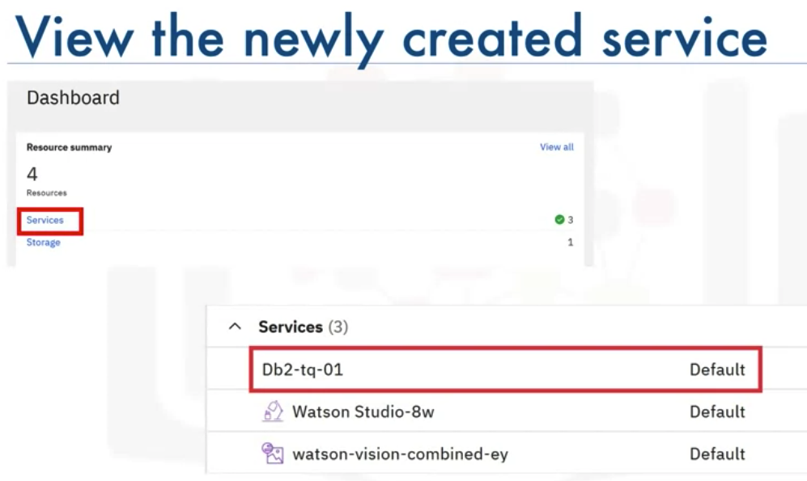
Create Database Instance on Cloud
Introduction to Relational Databases and Tables

Slide 9
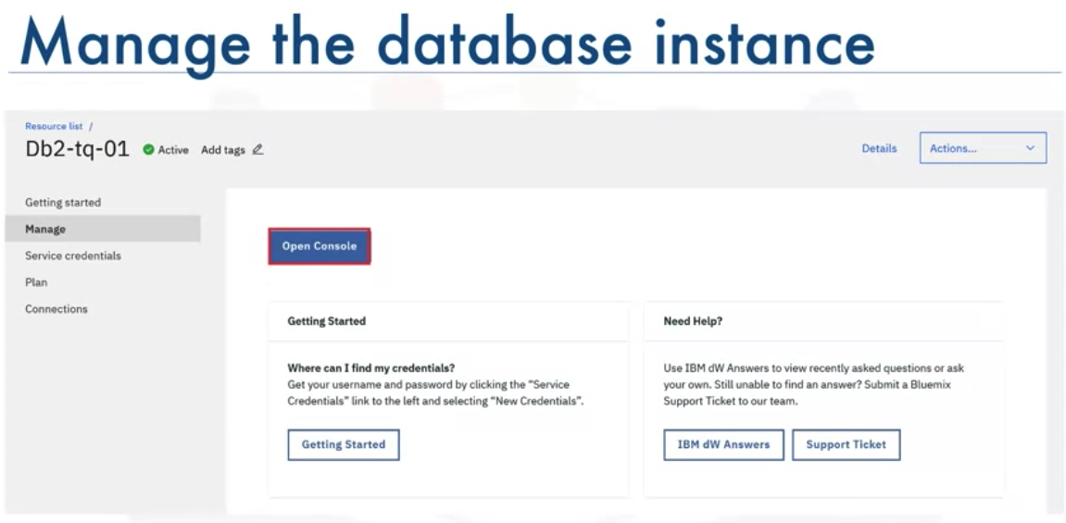
Create Database Instance on Cloud
Introduction to Relational Databases and Tables

Slide 10
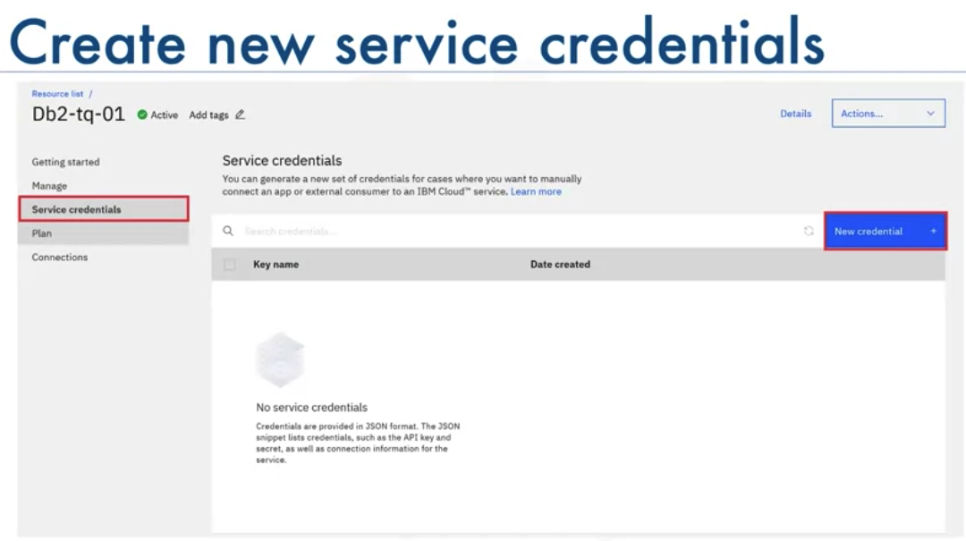
Create Database Instance on Cloud
Introduction to Relational Databases and Tables

Slide 11
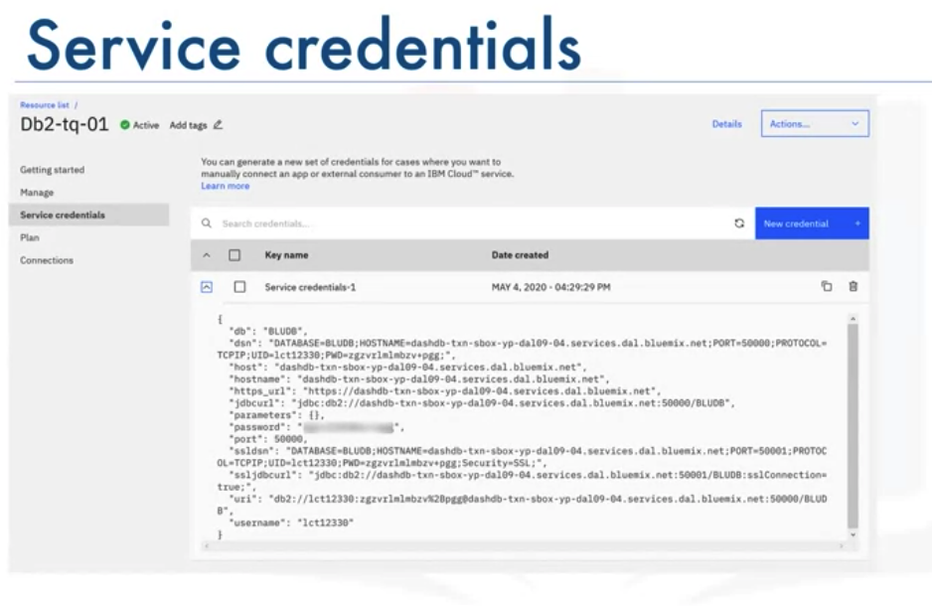
Create Database Instance on Cloud
Introduction to Relational Databases and Tables

Slide 12
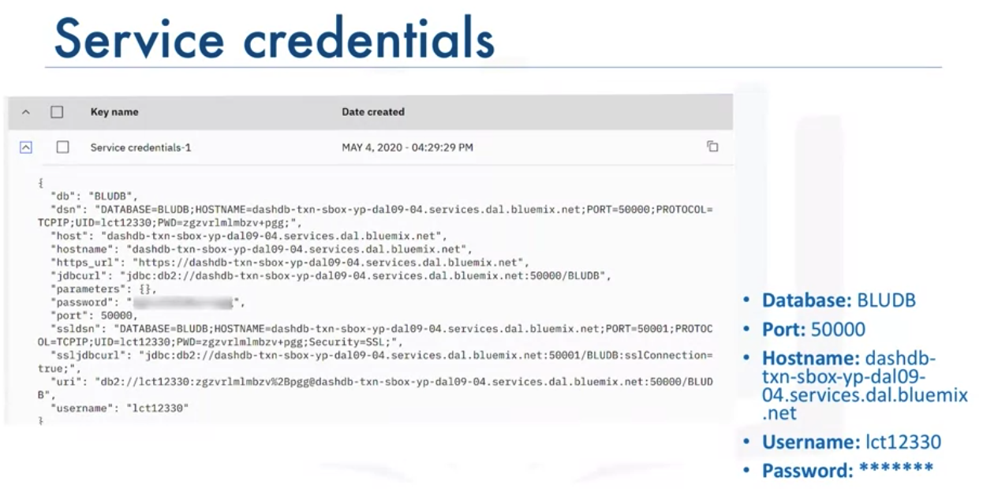
Create Database Instance on Cloud
Introduction to Relational Databases and Tables

Slide 13
Types of SQL Statements
DDL( Data Definition Language) statements:
  Define, change, or drop data
  Common DDL: CREATE, ALTER, TRUNCATE, DROP
DML( Data Manipulation Language) statements:
  Read and modify data
  CRUD operations( Create, Read, Update, Delete)
  Common DML: INSERT, SELECT, UPDATE, DELETE
Introduction to Relational Databases and Tables

Slide 14
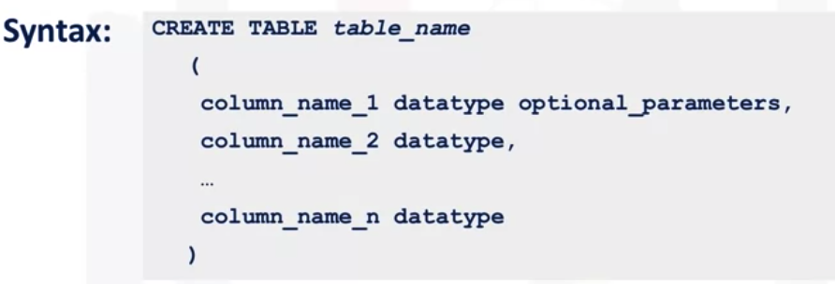
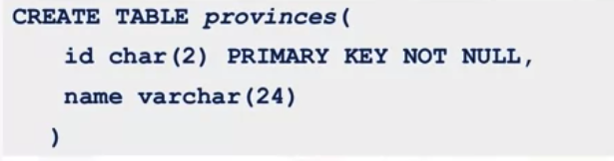
CREATE table
Introduction to Relational Databases and Tables

Slide 15
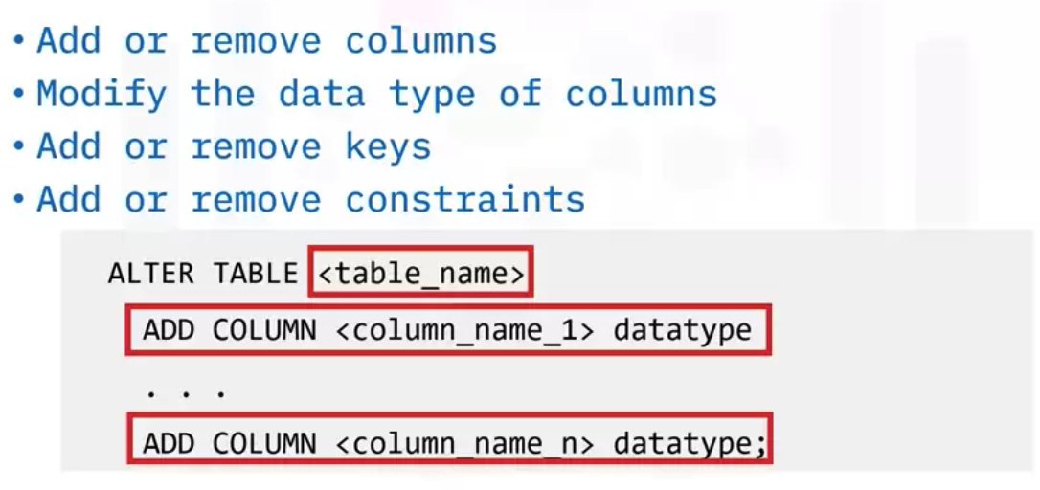
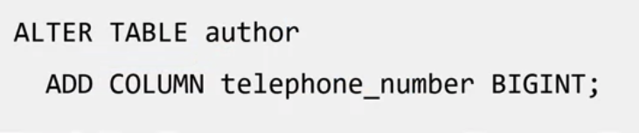
Alter table- add column
Introduction to Relational Databases and Tables

Slide 16
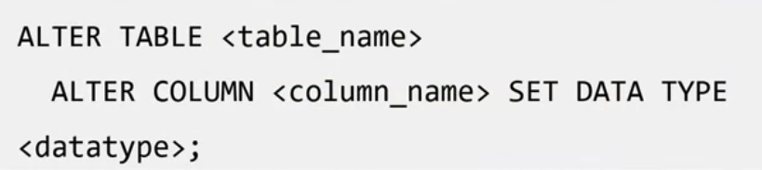
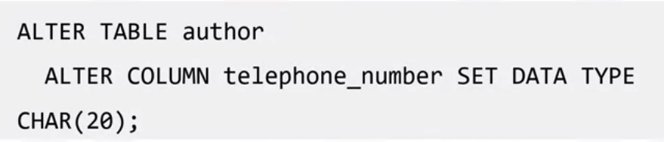
Alter table- data type of column
Introduction to Relational Databases and Tables

Slide 17
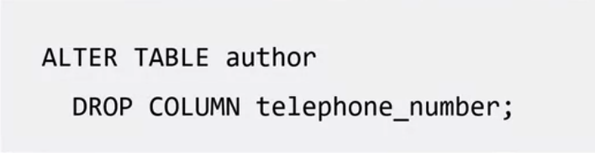


Alter table- drop column
Introduction to Relational Databases and Tables

Slide 18
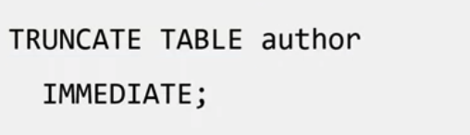
Alter table- add
you might want to just delete the data in a table rather than deleting the table itself.
While you can use the DELETE statement without a WHERE clause to do this
You use the TRUNCATE TABLE statement to delete all of the rows in a table.
Introduction to Relational Databases and Tables

Slide 19
Summary
Compose and execute CREATE TABLE, ALTER, DROP, and TRUNCATE statements hands-on on a live database.
Create a database instance on the Cloud
Describe basic relational database concepts including tables, primary keys and foreign keys.
Compare and contrast Data Definition Language and Data Manipulation Language.
Develop ALTER, DROP and TRUNCATE statements.
Explain the syntax of the CREATE TABLE statement.
Introduction to Relational Databases and Tables

Slide 20
Q & A
Introduction to Relational Databases and Tables

